Slide 1
IN723 MPLS
MPLS VPNs

Slide 2
Resources
What is a VPN
http://www.cisco.com/c/en/us/about/press/internet-protocol-journal/back-issues/table-contents-18/what-is-a-vpn.html
MPLS FAQ for beginners
http://www.cisco.com/c/en/us/support/docs/multiprotocol-label-switching-mpls/mpls/4649-mpls-faq-4649.html
Configure a basic MPLS VPN
http://www.cisco.com/c/en/us/support/docs/multiprotocol-label-switching-mpls/mpls/13733-mpls-vpn-basic.html

Slide 3
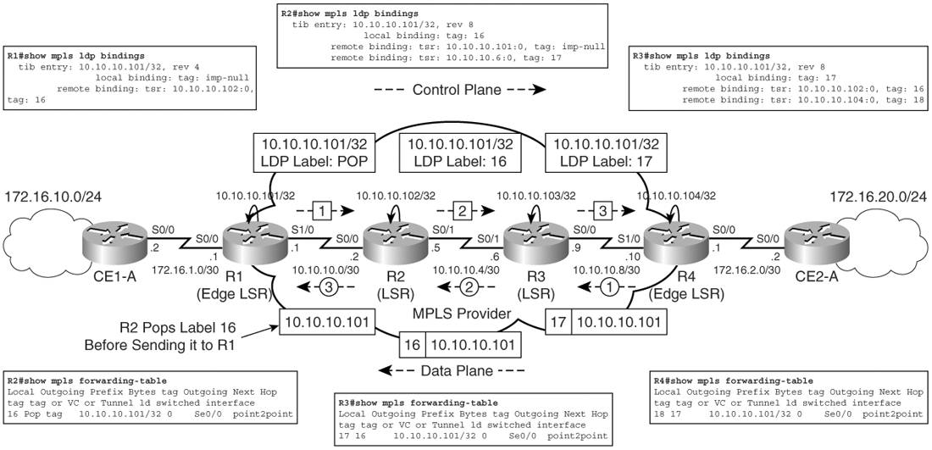
Control & Data Plane Forwarding Summary
Notes:
The figure shows the control plane operation for prefix 10.10.10.101/32 from R1 to R4 & data plane R4 to R1
R1 sends an implicit null or the POP label to R2
R2 assigns label 16 to 10.10.10.101/32. This label value is propagated to R3
On R3 prefix 10.10.10.101/32 has been assigned a local label of 17 and an outgoing label of 16.
The outgoing label is received from the Router R2.
The local label of 17 has been propagated during label distribution to Router R4
Label 17 is used by R4 in the data forwarding path for data destined to prefix 10.10.10.101/32 (R1)
R3 does an LFIB lookup and swaps label 17 for 16 and forwards that data packet to R2
R2 receives the data packet from R3, performs penultimate hop pop function, removes label 16, and forwards the data packet to R1

Slide 4
MPLS VPNs
VRFs provide customer isolation on PE
P routers provide label switching between PE routers and are unaware of VPN routes
Multiprotocol BGP is configured between PE routers to carry VPN (customer) routes
CE routers exchange IPv4 routes with PE routers
CE routers are unaware of P routers

Slide 5
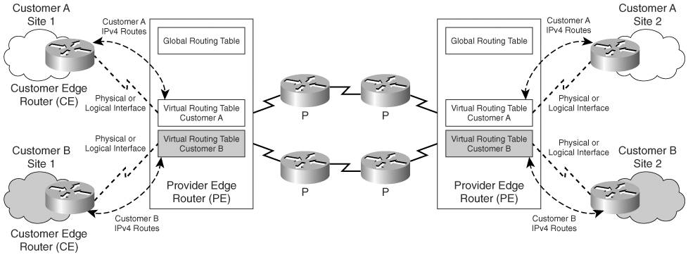
MPLS VPN Routing Model

Slide 6
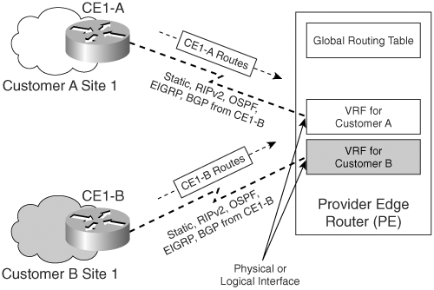
VRF
Notes:
CE to PE close up

Slide 7
Route Distinguisher
An RD is a 64-bit unique identifier that is prepended to the 32-bit customer prefix or route learned from a CE router
The resulting unique 96-bit address can be transported between the PE routers in the MPLS domain
VPNs can use overlapping address space (RD makes unique)
Known as a VPNv4 address
VPNv4 addresses are exchanged between PE routers in
the provider network
Notes:
Goal is to provide a unique address (therefore can use overlapping address space between VPNs)
RD does not define VPN membership

Slide 8
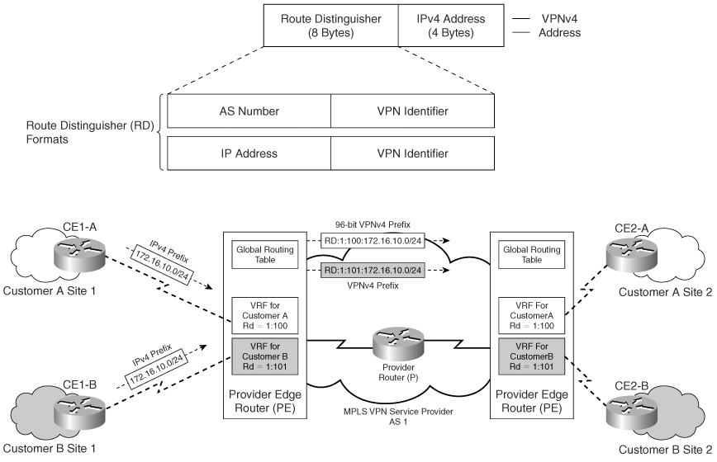
Route Distinguisher

Slide 9
MP-BGP VPN Label
The protocol used for exchanging VPNv4 routes between PE routers is multiprotocol BGP (MP-BGP)
MP-BGP is responsible for assignment of a VPN label creating a 2 label stack
Packet forwarding in an MPLS VPN mandates that the PE router specified as the next hop (when advertised to other PE) is the same router that assigns the VPN label

Slide 10
VPN Label
The VPN label (3 bytes) is assigned by the PE router’s MP-BGP process
It is assigned for each prefix learned from the connected CE router within a VRF
The VPN label is only understood by the egress PE that is directly connected to the CE router advertising the prefix
The VPN label is used for sending customer traffic through an MPLS network (2 label stack) and finally to the egress interface on the destination PE

Slide 11
Route Targets
Route targets (RTs) are additional identifiers used in the MPLS VPN domain that identify the VPN membership of the routes learned from that particular site
RTs are implemented by the use of extended BGP communities
The higher order 16 bits of the BGP extended community (64 total bits) are encoded with a value corresponding to the VPN membership of the specific site

Slide 12
Route Targets
The export route target identifies VPN membership and is associated to each VRF
The export route target is appended to a customer prefix when it is converted to a VPNv4 prefix by the PE router and propagated in MP-BGP updates
The import route target is associated with each VRF and identifies the VPNv4 routes to be imported into the VRF for the specific customer
Notes:
Import and Export route-targets are usually the same. Though can be manipulated to allow inter VPN communication.
Multiple Import & Export route-targets can be configured per VRF

Slide 13
Route Targets
A single prefix can be associated to more than one export route target when propagated across the MPLS VPN Network
The RT values can be used to implement complex VPN topologies in which a single site can be a part of more than one VPN
RT values can also be used to perform selective route importing into a VRF when VPNv4 routes are learned in MP-iBGP Updates

Slide 14
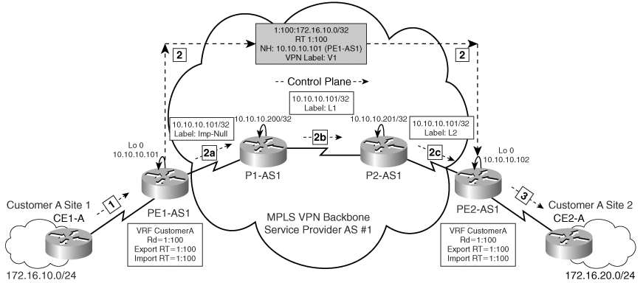
MPLS VPN Control Plane Operation
Notes:
Step 1
IPv4 update for network 172.16.10.0 is received by the egress PE router (data plane).
Step 2
PE1-AS1 accepts and transforms the IPv4 route, 172.16.10.0/24 to a VPNv4 route by assigning an RD 1:100 and RT 1:100 based on the VRF configuration on PE1-AS1
It then allocates a VPNv4 label V1 to the 172.16.10.0/24 update and rewrites the next-hop attribute to the PE1-AS1 loopback0 IP address 10.10.10.101
Step 3
PE2-AS1 has the VRF configured to accept routes with RT 1:100 and therefore translates the VPNv4 update to IPv4 and inserts the route in VRF for Customer A
It then propagates this route to the CE2-A
TRANSPORT (IGP) label
PE1-AS1 loopback 10.10.10.101 is reachable via IGP (OSPF) and LDP
Shows label propagation for prefix 10.10.10.101/32 from PE1-AS1 to PE2-AS1 inside the provider network
This propagation takes place as soon as the MPLS VPN provider network is established and is always in place prior to any VPNv4 prefix being propagated across the MPLS VPN provider network
Is the top label (of a 2 label stack). It is swapped or popped (PHP) at each LSR.
The VPN label (bottom label) is unchanged.

Slide 15
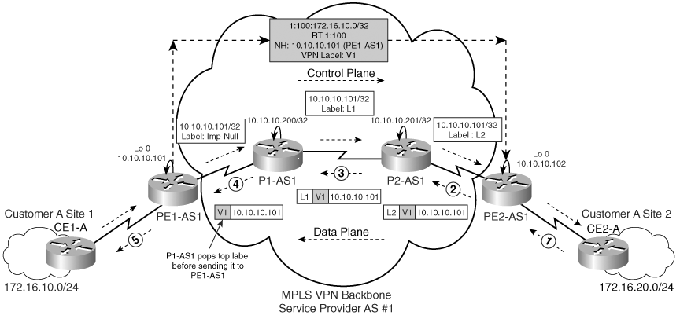
MPLS VPN Data Plane Operation
Notes:
Step 1
CE2-A originates a data packet with the source address of 172.16.20.1 and destination of 172.16.10.1
Step 2
PE2-AS1 receives the data packet, determines the next hop as 10.10.10.101 and appends the VPN label V1 and LDP label L2 and forwards the packet to P2-AS1
Step 3
P2-AS1 receives the data packet destined to 172.16.10.1 and swaps LDP label L2 with L1
Step 4
P1-AS1 receives the data packet destined to 172.16.10.1 and pops the top label because it receives an implicit-null label mapping for 10.10.10.101/32 from PE1-AS1
The resulting labelled packet (with VPN Label V1) is forwarded to PE1-AS1
Step 5
PE1-AS1 pops the VPN label and forwards the data packet to CE1-A where the 172.16.10.0 network is located

Slide 16
MPLS VPN Data Plane Operation
The top label in the label stack is the label assigned for the egress PE routers next-hop address (PE loopback learnt via IGP)
The second label in the label stack is the VPN label as assigned by the egress PE router connected to the CE router advertising the prefix

Slide 17
MPLS VPN Data Plane Operation
The egress PE router identifies the VPN label assigned with a VRF and performs an IP lookup in the VRF table to identify the next hop toward the destination
When data is forwarded across the MPLS-enabled core (toward egress PE router), the top label (LDP assigned) in the label stack is the only one swapped
The VPN label is kept intact (untouched) and is removed only by the egress/downstream PE router

Slide 18
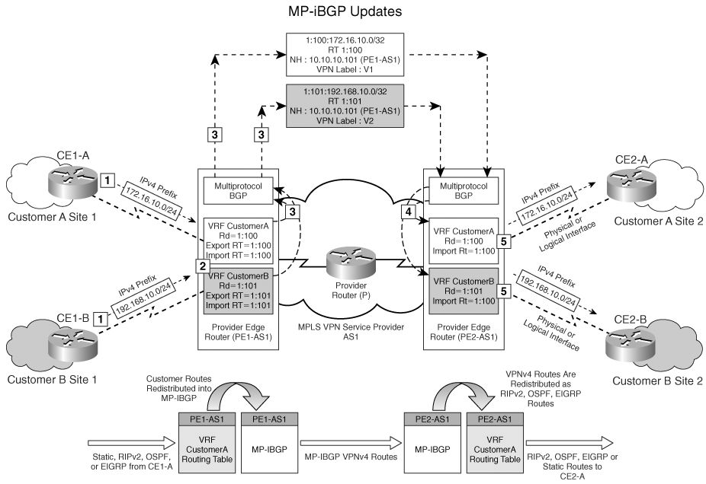
Route Distinguisher, Route Targets, MP-BGP, and Address Families
The format of a RT is the same as an RD value
Notes:
Control Plane
RT & RD operation – NOTE import RT = 1:100 on PE2 for VRF CustomerB (typo)
The following processes occur during route propagation in an MPLS VPN, as shown in the figure:
1. The prefix 172.16.10.0/24 is received from CE1-A which is part of VRF CustomerA on PE1-AS1
2. PE1 associated an RD value of 1:100 and an export RT value of 1:100 as configured in the VRF definition on the PE1-AS1 router.
3. Routes learned from connected CE routers CE1-A are redistributed into the MP-BGP process on PE1-AS1.
Prefix 172.16.10.0/24 is prepended with RD value of 1:100 and appended with the route target extended community value (export RT) of 1:100 prior to sending the VPNv4 prefix as part of the MP-iBGP update between PE routers.
VPN label assigned for each prefix
4.The MP-BGP update is received by the PE router PE2, and the route is stored in the appropriate VRF table for Customer A based on the route-target
5. The received MP-BGP routes are redistributed into the VRF PE-CE routing processes, and the route is propagated to CE2-A

Slide 19
MP-BGP PE-PE Config
router bgp 100
bgp router-id 10.1.1.1
no bgp default ipv4-unicast *disables default unicast peering
bgp log-neighbor-changes
neighbor 10.6.6.6 remote-as 100
neighbor 10.6.6.6 description PE R6
neighbor 10.6.6.6 update-source Loopback0
neighbor 10.9.9.9 remote-as 100
neighbor 10.9.9.9 description PE R9
neighbor 10.9.9.9 update-source Loopback0
!
address-family vpnv4
neighbor 10.6.6.6 activate
neighbor 10.6.6.6 send-community extended
neighbor 10.9.9.9 activate
neighbor 10.9.9.9 send-community extended
exit-address-family
Notes:
the no bgp default ipv4-unicast command will prevent BGP from automatically assigning each newly defined neighbor into address-family ipv4 section. You will then be required to add every defined neighbor to each intended address family manually – it won’t be done automatically
the address-family ipv4 is not visible by default. Carries BGP prefixes associated with the global table

Slide 20
MPLS VPN Config Steps (PE to PE)
Configure the remote MP-iBGP neighbor and use the loopback interface as the source of BGP messages and updates
Configure the address family for VPNv4 under the BGP configuration process. This step allows you to enter the VPNv4 address family to activate the VPNv4 neighbors
Activate the iBGP neighbor, which is essential for transporting VPNv4 prefixes across the service provider backbone
Configure the propagation of the extended communities with BGP routes so as to enable RT propagation which identifies the VPNs that the routes have to be imported into

Slide 21
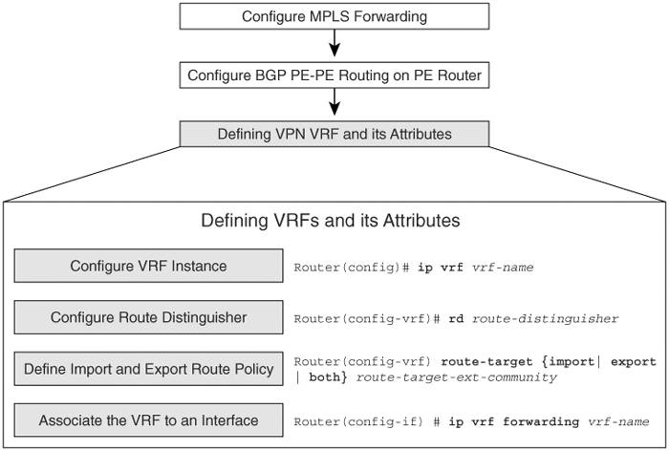
VRF Config

Slide 22
VRF Config
ip vrf CUSTA
rd 999:99
route-target export 999:99
route-target import 999:99
!
ip vrf CUSTB
rd 34:34
route-target export 34:34
route-target import 34:34
interface FastEthernet0/0
ip vrf forwarding CUSTA
ip address 192.168.17.1 255.255.255.0
RD = Route distinguisher = creates unique addresses allowing overlapping address space
Route-target = defines VPN membership
RD & route-target have no relationship and need not match

Slide 23
PE-CE Configuration
No specific configuration other than the regular routing protocol configuration is required on the CE routers
BGP, OSPF, RIP, ISIS, EIRGP, Static are all supported

Slide 24
PE-CE Configuration
On the PE router, VRF routing contexts (or address family contexts) are required for route exchange between the PE and CE
These routes are then mutually redistributed with the MP-BGP process per VRF on the PE

Slide 25
PE-CE Static
ip vrf CUSTA
rd 999:99
route-target export 999:99
route-target import 999:99
!
interface FastEthernet0/0
ip vrf forwarding CUSTA
ip address 192.168.17.1 255.255.255.0
!
ip route vrf CUSTA 200.10.0.0 255.255.0.0 192.168.17.7
!
router bgp 1
address-family ipv4 vrf CUSTA
redistribute static

Slide 26
PE-CE OSPF
ip vrf CUSTB
rd 34:34
route-target export 34:34
route-target import 34:34
!
interface Serial2/1
ip vrf forwarding CUSTB
ip address 192.168.13.1 255.255.255.0
!
router ospf 3 vrf CUSTB
redistribute bgp 100 subnets
network 192.168.13.1 0.0.0.0 area 0
router bgp 1
address-family ipv4 vrf CUSTB
redistribute ospf 3 vrf CUSTB match internal external 1 external 2

Slide 27
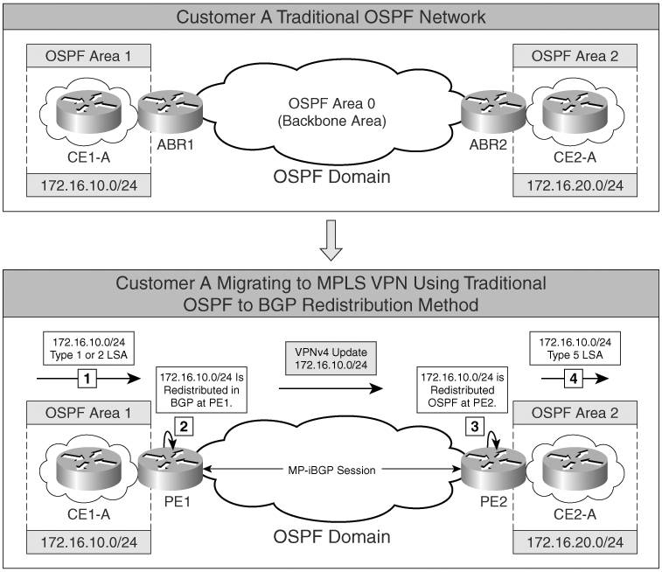
PE-CE OSPF
Notes:
1. Network 172.16.10.0/24 is advertised to the PE1 router by CE1-A as a Type 1 or Type 2 link-state advertisement (LSA).
2. Traditional OSPF-BGP route redistribution takes place where 172.16.10.0/24 is redistributed into BGP at PE1. This route is then propagated as a VPNv4 route to PE2.
3. At PE2, the BGP VPNv4 prefix 172.16.10.0/24 is redistributed in OSPF.
4. This redistributed route 172.16.10.0/24 is propagated as an external LSA Type 5 OSPF route.
Type 5 LSAs go everywhere within OSPF (unless using stub) which may be undesirable

Slide 28
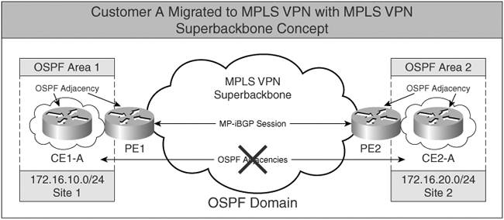
PE-CE OSPF

Slide 29
PE-CE OSPF
Superbackbone functions as Area 0
PE routers appear as ABRs
OSPF information is carried across MPLS VPN superbackbone using BGP extended communities
No OSPF adjacencies or flooding in the superbackbone
Notes:
Sham-links are out of scope for this course

Slide 30
PE-CE OSPF
OSPF process IDs must match between PEs or routes appear as External. Alternatively configure domain-id
Matching process id’s or domain-id’s result in OSPF routes appearing as Inter Area
Notes:
Telecom NGN does not support inter or intra area routes (no sham link).
Can cause problems in some routing scenarios (back door links).

Slide 31
PE-CE BGP
ip vrf vpn1
rd 100:1
route-target export 100:1
route-target import 100:1
!
interface Serial1/0
ip vrf forwarding vpn1
ip address 192.168.1.6 255.255.255.252
!
router bgp 1
address-family ipv4 vrf vpn1
neighbour 192.168.1.5 remotes-as 65001
neighbour 192.168.1.5 activate
Both PE & CE run eBGP
Redistribution not required
Notes:
PE config above

Slide 32
Verification
PE1-AS1#show ip vrf
Name Default RD Interfaces
CustomerA 1:100 Se1/0 Lo1
show ip vrf interfaces
Interface IP-Address VRF Protocol Serial1/0 172.16.1.1 CustomerA up
Lo1 172.16.100.1 CustomerA up

Slide 33
Verification
show mpls forwarding table
Local Outgoing Prefix Bytes tag Outgoing Next Hop tag tag or VC or Tunnel Id switched interface 16 16 192.168.1.97 255.255.255.255 \ 0 Se0/0.111 point2point 17 Pop tag 192.168.1.112 255.255.255.240 \ 0 Se0/0.111 point2point 18 17 192.168.1.64 255.255.255.240 \ 0 Se0/0.111 point2point 19 Pop tag 192.168.1.81 255.255.255.255 \ 0 Se0/0.111 point2point 20 18 192.168.1.33 255.255.255.255 \ 0 Se0/0.111 point2point 21 20 150.1.2.16 255.255.255.240 \ 0 Se0/0.111 point2point 22 22 150.1.2.32 255.255.255.240 \ 0 Se0/0.111 point2point
Notes:
RIB = show ip route
FIB = show ip cef
LIB = show mpls ldp bindings
LFIB = show mpls forwarding-table

Slide 34
Verification
show ip bgp vpnv4 all
BGP table version is 2024361, local router ID is 202.50.231.3
Status codes: s suppressed, d damped, h history, * valid, > best, i - internal,
r RIB-failure, S Stale
Origin codes: i - IGP, e - EGP, ? - incomplete
Network Next Hop Metric LocPrf Weight Path
Route Distinguisher: 2570:95 (default for vrf vrf-testing)
*> 202.50.231.64/27 202.50.231.164 21 32768 ?
*> 202.50.231.160/27
0.0.0.0 0 32768 ?
* i202.50.231.208/29
202.50.231.4 0 100 0 ?
*> 0.0.0.0 0 32768 ?
*> 210.54.141.0/25 202.50.231.164 2 32768 ?
Route Distinguisher: 2570:200 (default for vrf vrf-mobile-peering)
* i10.2.4.0/28 202.50.231.4 0 100 0 ?
*> 0.0.0.0 0 32768 ?
* i118.148.4.0/24 202.50.231.4 1 100 0 ?
*> 10.2.4.5 1 32768 ?
Route Distinguisher: 2570:300 (default for vrf vrf-mobile-services)
*> 10.104.32.0/19 202.50.231.36 200 0 65150 4771 65534 ?
*> 10.104.64.0/18 202.50.231.36 200 0 65150 4771 65534 ?
*> 10.104.128.0/18 202.50.231.36 200 0 65150 4771 65534 ?
Notes:
Can also see routes per RD or VRF

Slide 35
Verification
show ip bgp vpnv4 vrf <vrf-name> labels
Network Next Hop In label/Out label
Route Distinguisher: 2570:700 (vrf-corporate-peering)
146.171.0.0 202.50.231.4 1311/198
146.171.254.3 1311/nolabel
146.171.6.0/24 202.50.231.4 1310/197
146.171.254.5 1310/nolabel
146.171.13.64/26 202.50.231.4 1309/196
146.171.254.5 1309/nolabel
Notes:
Show the MP-BGP assigned VPN labels

Slide 36
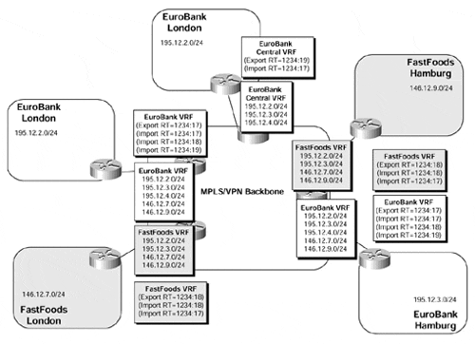
VPN example
Notes:
FastFoods London, Hamburg & Eurobank Hamburg, London can all communicate with each other.
Only Eurobank London & Hamburg can communicate with Eurobank London central VRF.

Slide 37
VPN Topology Examples
Full Mesh – Export and import the same everywhere
Central Services – client sites can access services at one or more central sites, but cannot communicate with each other
Hub and spoke – spoke sites send all traffic toward a central location

Slide 38
Import / Export Maps
Import maps & export maps can be used to selectively import or export route-targets per prefix
ip vrf
import map IMPORT_MAP
!
ip extcommunity-list 1 permit rt 100:200
!
route-map IMPORT_MAP permit 10
match ip address prefix-list PREFIX_SELECTION
match extcommunity 1

